Slide 1
E-Commerce Platform
A Seamless Online Shopping Solution

Slide 2
Abstract
Our eCommerce platform provides businesses with a seamless online shopping experience. It enables owners to track sales, manage inventory, and optimize their operations effectively. The system ensures growth, profitability, and competitiveness in the digital marketplace.

Slide 3
Introduction
The platform is designed to simplify online business operations by offering tools for sales management, inventory tracking, and customer engagement. It is scalable, making it suitable for startups and enterprises.

Slide 4
Literature Review
Research shows that eCommerce platforms are evolving rapidly to meet modern demands. Key areas of focus include sales management, user-friendly dashboards, and integration with modern technologies for better business performance.

Slide 5
Problem Statement & Proposed Solution
Problem: Businesses often face difficulties in managing sales, inventory, and customer engagement through traditional methods.
Proposed Solution: Our eCommerce platform simplifies business operations, provides real-time insights, and helps businesses remain competitive.

Slide 6
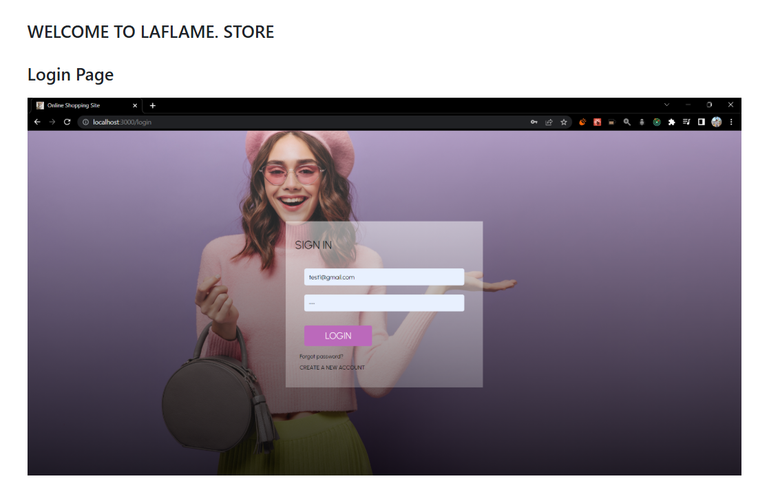
Diagrams

Slide 7
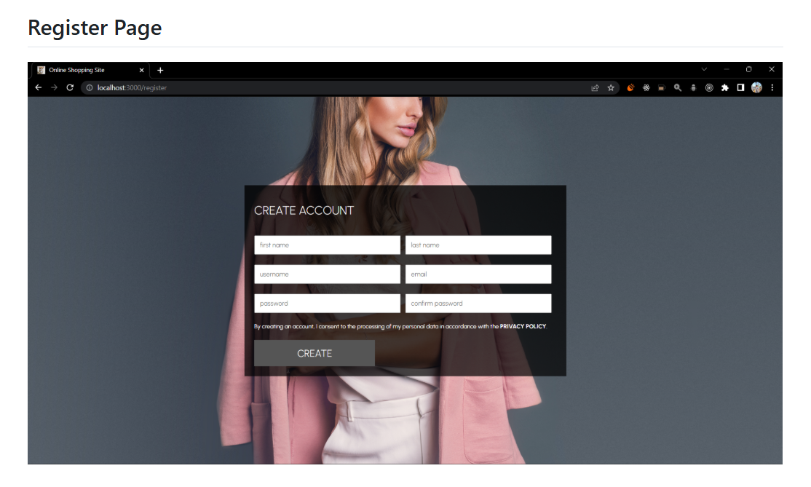
Diagrams

Slide 8
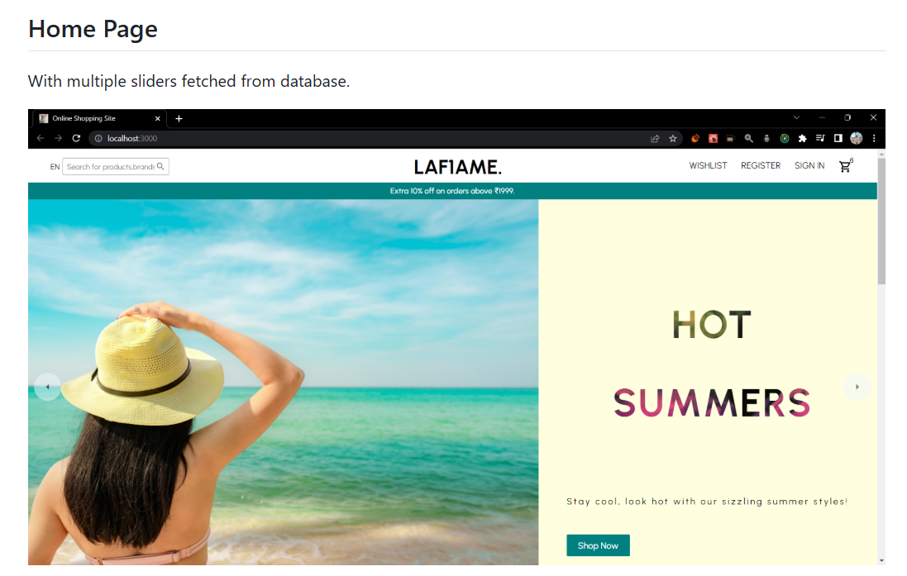
Diagrams

Slide 9


Slide 10


Slide 11


Slide 12


Slide 13
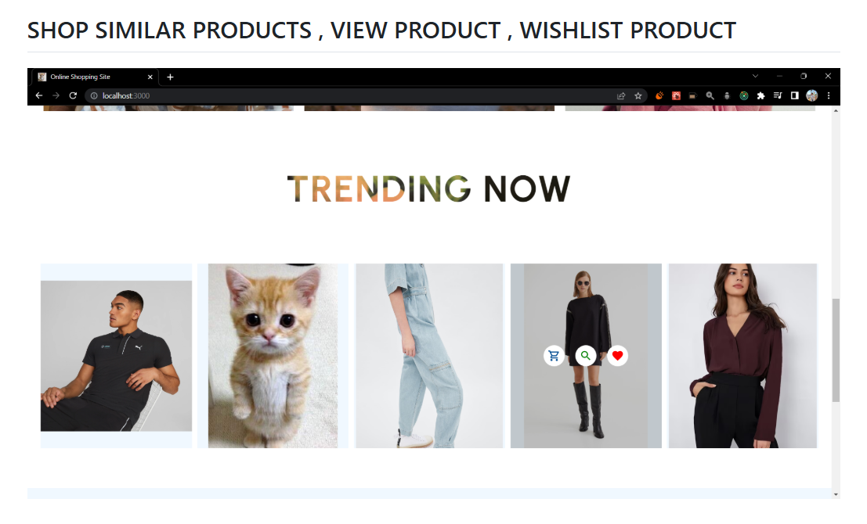

Slide 14
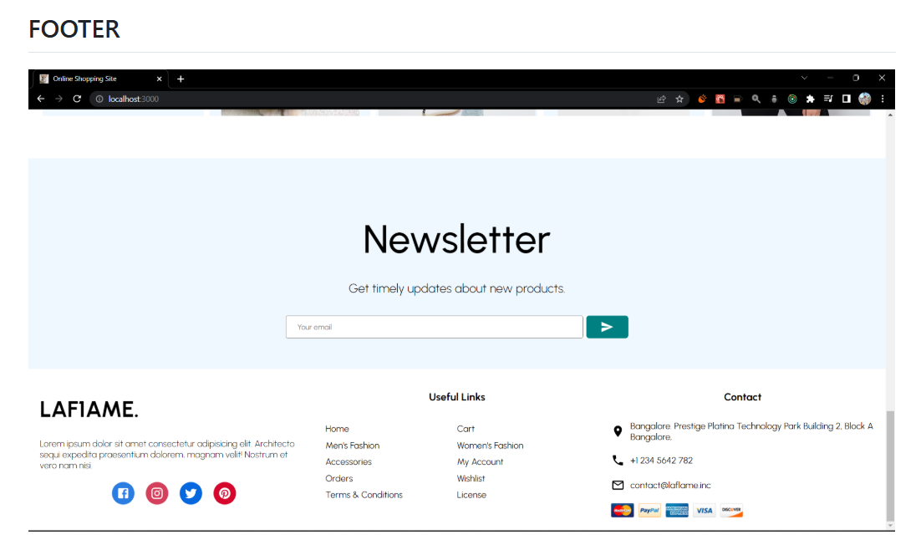

Slide 15
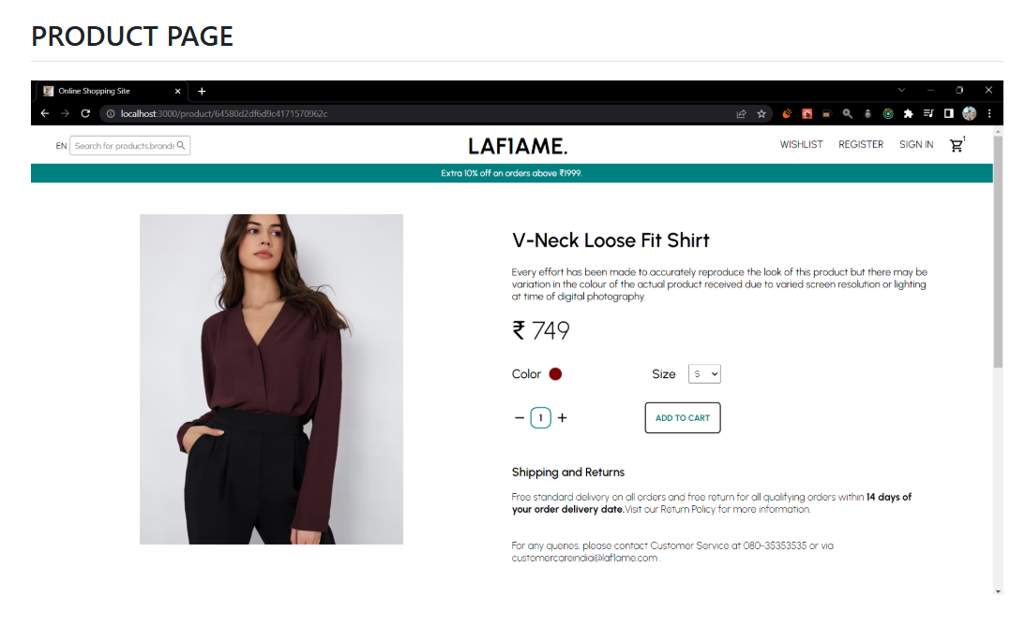

Slide 16
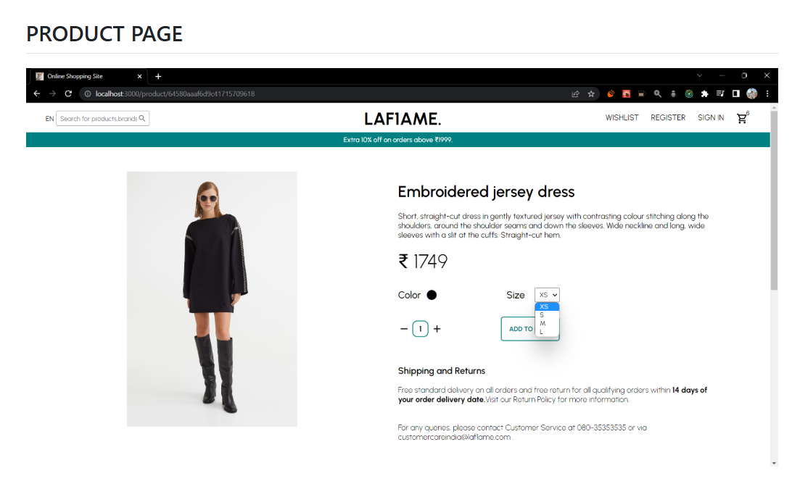

Slide 17
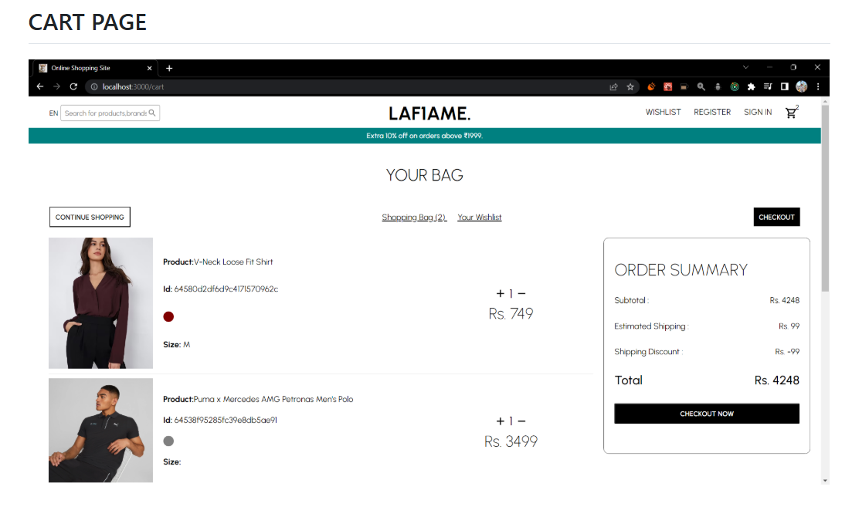

Slide 18
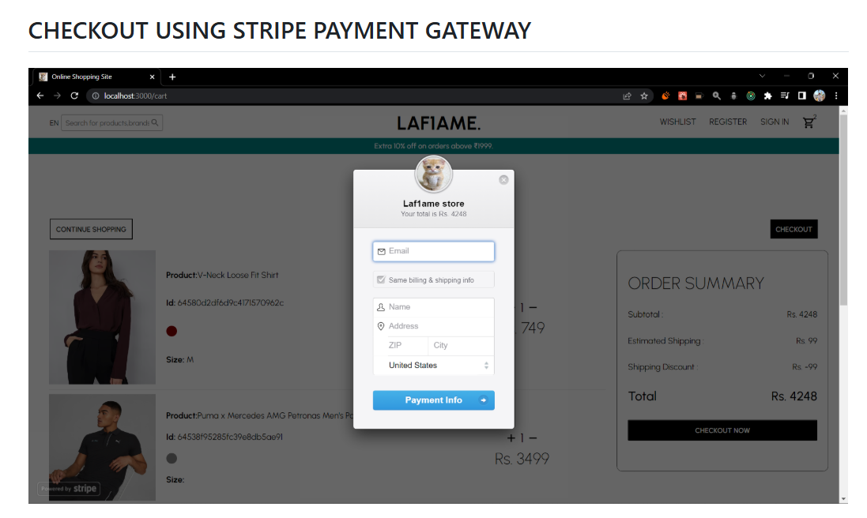

Slide 19
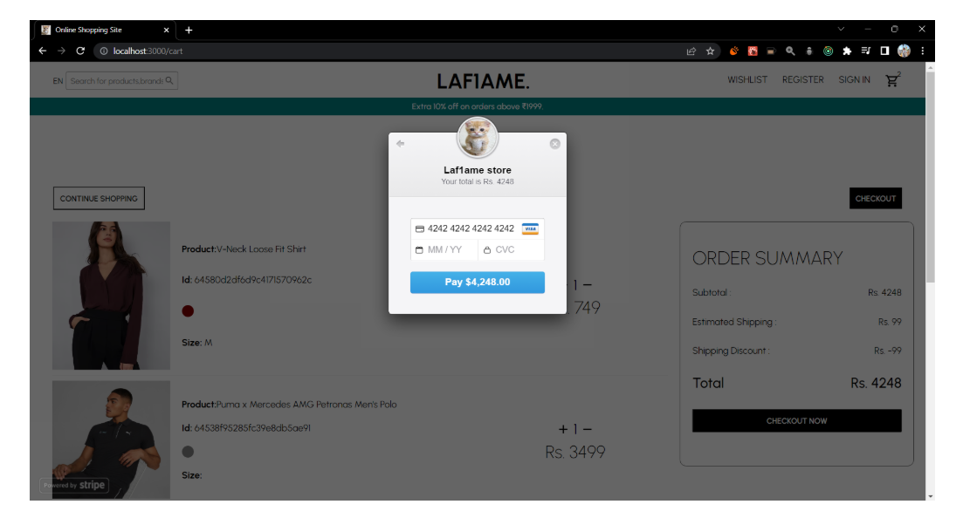

Slide 20
Future Work
• Integration with AI-based recommendation systems
• Mobile app version of the platform
• Enhanced security with blockchain
• Multi-language and multi-currency support

Slide 21
References
1. Research papers on eCommerce evolution
2. Case studies of online shopping platforms
3. Industry reports on digital business trends
4. Academic literature on business management systems

